Slide 1
Identifying HARPed Loans
January 2016

Slide 2
OVERVIEW OF HARP AND STREAMLINE REFI PROGRAMS
Key Differences in Streamline Refi, HARP 1.0 and HARP 2.0 Programs
 | HARP 2.0 | HARP 1.0 | Streamline Refi
Period | Since November 2011 | April 2009 – October 2011 | Pre-HARP 1.0
Appraisal | Mostly Automated | Manual/automated appraisal but manual appraisal required in most cases | Manual appraisal
Income & Asset documentation | Reduced requirement in September 2012--same servicers are required to verbally verify a borrower's income; New lenders are required to have documentation | Need documentation; in some cases need two year history of income | Stated Income/employment
Reps & Warrants | Further relief of reps & warrants for original loan in September 2012; Relief of new loan reps & warrants risk with 12 month clean pay following origination | Seller retains all the original reps & warrants regarding value condition and marketability; no additional relief on the new loan | Any previous rep & warrant relief on the original loan does not apply to the new loan
LTV restriction | Extended to above 125% LTV in October 2011 | LTV ceiling at 105% when announced in March 2009; Raised ceiling from 105% to 125% in July 2009 | under 95%-100%
MI | MI transfers made easier | No new MI required but transfer of MI is cumbersome | New MI required
LLPA | Lowered LLPA to 75bp max | Standard | Standard
Source: Citigroup Research

Slide 3
INTRODUCTION
1
Importance of identifying HARP loans
Loans that have been refinanced through the Home Affordable Refinance Program (HARP) generally prepay slower than other refinance loans that have undergone full underwriting. As a streamline refinance program, HARP generally made only minimal requirements of borrowers, and such borrowers may have trouble qualifying for regular refinances.
2
Existing algorithms for identifying HARPed Loans
Prior to August 2013:
This is the period prior to Freddie Mac providing loan-level credit information for fully underwritten mortgages
MI matches were used to identify potential HARPed loans with OLTV > 80% and loan purpose as Refi-NCO (No Cash-out)
Although HARP targets with LTVs > 80%, loans with lower OLTVs are counted as part of HARP because the Agencies essentially suspended their streamline refi programs after the financial crisis and currently rely on the HARP program for all streamline processing
After August 2013:
New Freddie Mac and Fannie Mae loan-level credit information are used to identify 30-year fixed –rate HARP loans by mapping the credit dataset to the standard database without restrictions on the LTV ratio
The credit data set has about a one year lag, which means that recently originated loans cannot be identified as being HARPed or not using the current algorithm

Slide 4
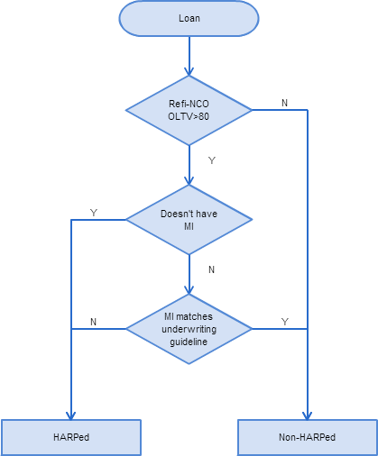
EXISTING ALGORITHM I MI Matching Method
Three Step Mapping
Step 1: The loan should be originated after June 2009 as a refi-NCO loan, with Origination LTV >80%. Otherwise, it’s Non-HARPed.
Step 2: If the loan doesn’t have MI, we match it as HARPed loan;
If not, go to step 3.
Step 3: For the loans that potentially carry over MI check whether MI matches current underwriting guidelines. If there’s no match, then it’s a HARPed loan.
Cons
Cannot match loans with OLTV equal or lower than 80%.
Highly sensitive to the correctness of MI underwriting guidelines.

Slide 5
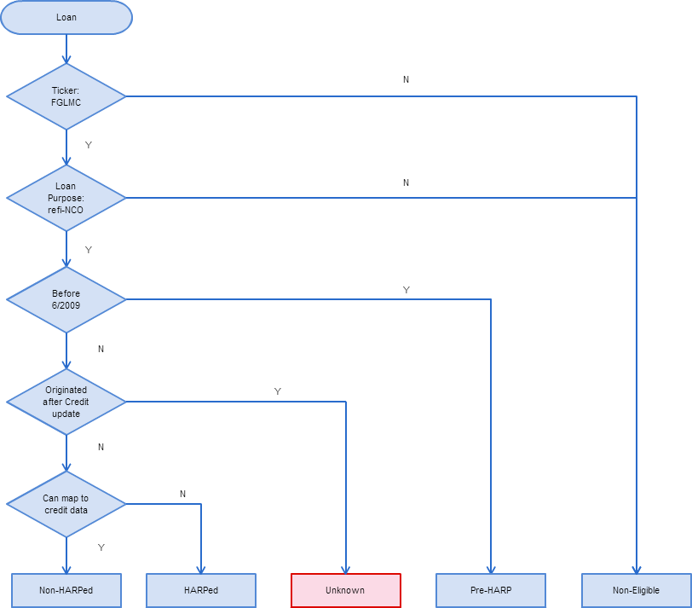
EXISTING ALGORITHM II Credit Dataset Mapping Method
Credit Data Mapping
No restrictions on OLTV > 80%.
More accurate as there is no dependency on MI underwriting criteria.
Cons
The credit data set has about a one year lag, meaning we don’t have the most recent origination data. Consequently, we have to mark the HARP status as unknown for recently (within the last year) originated loans.

Slide 6
EXISTING ALGORITHM II Results from the Credit Dataset Mapping Method
Pre-HARP
HARPed
Non-HARPed
Non-eligible: Purchas, refi-CO
The blue area can be consider as non-HARPed loans; brown area is HARPed loans percentage.
Red area is the loans originated within the most recent year. The credit dataset has a gap on this area.
Need to improve the mapping for the red area.

Slide 7
ENHANCED ALGORITHM
Y: HARPed
HARP% = 100
LTV > 80
MI Test
Using Algo I
N: Non-HARPed
HARP% = 0
HARP % for each loan
Unknown Refi Loans
LTV <= 80
Ratio
HARP/Total Refi
Logistic Regression Model for HARP Ratio
Estimate a percentage chance the loan is originated from the HARP program for each loan.
*This ratio will be different for FNMA vs FHLMC. See Slide 9.

Slide 8
ENHANCED ALGORITHM Adjustment Factor: LTV > 80%
In order to find out whether we need to adjust the result from the MI mapping algorithm, we test the two algorithms with LTV>80 loans. The HARP mapping numbers from them are fairly close to each other. In other words, there is no bias between the two mapping methods. Therefore, there is no need to adjust the result for LTV > 80 loans.

Slide 9


ENHANCED ALGORITHM Adjustment Factor: LTV <= 80%
For the loans with LTV <= 80, we use a % HARP adjustment factor to estimate the probability that a loan is coming from HARP program.
We generated the factor by calculate the ratio by:
$FHLMC Ratio= \frac{HARP Loan Count}{Total Refi−NCO Loan Count}$ ×100%
$FNMA Ratio= \frac{HARP Loan Count}{Total Refi Loan Count}$ ×100%
We use the credit mapping method to calculate the ratio based on the historical data.
The HARP % ratio is around 20% for FNMA and 35% for FHLMC according to the chart above. We will use these ratios to update the HARP % for the relevant loans.

Slide 10
ENHANCED ALGORITHM Adjustment Factor: LTV <= 80%
Logistic Regression Model for HARP Percentage
For loans with LTV <= 80, and originated after the most recent available credit data set, we cannot use neither Algorithm I or Algorithm II to estimate the percentage of loans that are HARPed. In order to solve the problem, we introduce a logistic regression model based on loan characteristics and indexes about the refinacible universe.
$$HARPed Percentage \sim Credit Score+SATO+OrigLoanSize+Refi \%+HARP Eligible \%$$
Loan Characteristics:
Credit Score: borrower’s credit score at origination. The lower cs, the higher probability the loan is HARPed.
SATO: the spread at origination for every borrower. The borrower pays higher spread normally has higher probability of HARPed
OrigLoanSize: the origination loan size. The lower loan size associates with higher chance a loan is HARPed.
Indexes about the Refinacible Universe:
Refinancible Percentage: The percentage of loans that has > 50 incentive to refinance. When the refi % is higher, means more people are rerinancible, hence the HAPed % with all refinance loans will be lower.
HARP Eligible Percentage: measures the percentage of refinancible loans that are eligible for HARP program. When the ratio goes high, the probability of loans are HARPed will be higher.

Slide 11
ENHANCED ALGORITHM Adjustment Factor: LTV <= 80%
Logistic Regression Model for HARP Percentage
The result below shows an out sample test of our logistic regression. Here we use 80% of data to train the model, and hold the other 20% as out sample test set. We can see the prediction is very close to the actual HARPed percentage.

Slide 12
ENHANCED ALGORITHM
Pre-HARP
HARPed
Non-HARPed
Non-Eligible: Purchas, refi-CO
Using the Enhanced Algorithm
Pre-HARP
HARPed
Non-HARPed
Non-Eligible: Purchas, refi-CO

